Slide 1
MDE for (large scale) safe distributed systems
MDE@SEI Summer School INRIA – ECNU Shanghai July 16-17 2015
Eric Madelaine
eric.madelaine@inria.fr
INRIA Sophia-Antipolis
University of Nice Sophia Antipolis
SCALE team

Slide 2
Context & people
Scale research team at INRIA Sophia-Antipolis
https://team.inria.fr/scale/
4 years of collaboration with SEI@ECNU:
Research (distributed systems, semantics, formal methods)
Common PhD
Master internships
Also:
International Master track “Ubiquitous Systems & Networks”
at University of Nice Sophia-Antipolis.
Internship (master / PhD) in France – INRIA Sophia-Antipolis
contact me: eric.madelaine@inria.fr
or: mzhang@sei.ecnu.edu.cn; hbzhu@sei.ecnu.edu.cn;

Slide 3
MDE for safe distributed systems
Thursday, July 16th , Afternoon(Course)
• 1) Introduction: academic and industrial examples: Distributed algorithms; distributed resiliant industrial infrastructure; QoS-aware elastic architecture for Cloud applications
• 2) GCM: a component-based programming model for safe distributed applications
• 3) VCE: a model-driven specification environment for GCM
Friday, July 17th , Morning: (Hands-on, Lab)
- Presentation and exercises with VCE:
• Tutorial and simple examples
Friday, July 17th , Afternoon: (Lab)
• 1) Course: VerCors theoretical background : behavioural models, model-checking, temporal logics, running the verification tools.
• 2) Hands-on with VCE and Vercors: continued…

Slide 4
Goals of the Course
Explore some features of component-based software
Fractal/GCM component model
GCM architecture and execution principles
VerCors: A software platform for (model-driven) specification and verification of GCM applications
Understand a non-trivial case-study in (model-checking) behavior verification
Lab sessions
Specification of distributed component architecture and behaviour with the VCE tools.

Slide 5
AGENDA (part 1)
Context and Motivation:
A short introduction to (safe) component-based applications
academic and industrial examples:
Distributed algorithms;
distributed resiliant industrial infrastructure;
QoS-aware elastic architecture for Cloud applications
Formal Methods and Component models:
Vocabulary and context:
specification, modeling, testing, verification…: Formal methods in the design flow of distributed/embedded systems
Fractal/GCM: a component-based programming model for safe distributed applications
VCE (VerCors Component Editor): a model-driven specification environment for GCM.

Slide 6
Distributed Components… Specification and Verification for distributed applications
Components
Grids
Interfaces
Distributed Systems
Clouds
Services
MultiCores
Message passing
Adaptation
Self Healing
Reconfiguration
Load Balancing
Self Optimizing

Slide 7
Distributed Components…
Components
Grids
Interfaces
Distributed Systems
Clouds
Services
MultiCores
Message passing
Adaptation
Self Healing
Reconfiguration
Load Balancing
Self Optimizing
Hard to program ?
Correct Behaviour ?
Correct Assembly ?

Slide 8
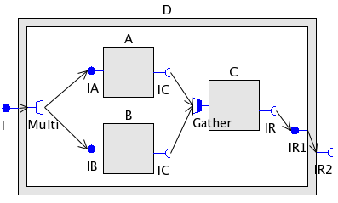
Do we need formal methods for developing component-based software ?
A
B
???
C
A
B
C2
C
Safe COTS-based development
=>
Behaviour Specifications
Safe management for complex systems
(e.g. replacement at runtime)

Slide 9
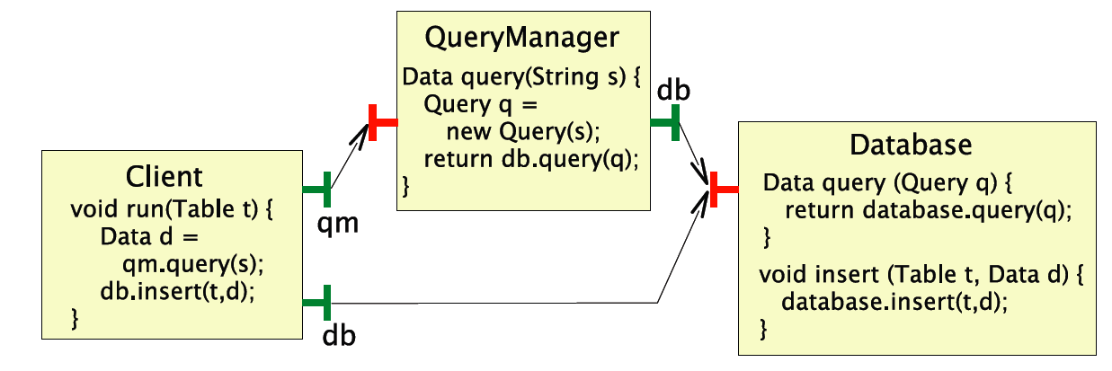
Is it more difficult for distributed asynchronous components ?
Yes !
Asynchrony creates race-conditions, dead-locks, etc.

Slide 10
AGENDA (part 1)
Context and Motivation:
A short introduction to (safe) component-based applications
academic and industrial examples:
Distributed algorithms;
distributed resiliant industrial infrastructure;
QoS-aware elastic architecture for Cloud applications
Formal Methods and Component models:
Vocabulary and context:
specification, modeling, testing, verification…: Formal methods in the design flow of distributed/embedded systems
Fractal/GCM: a component-based programming model for safe distributed applications
VCE (VerCors Component Editor): a model-driven specification environment for GCM.

Slide 11
The Fractal hierarchical model
Attribute
Controller
Binding
Controller
Lifecycle
Controller
Content
Controller
Server/Client Interfaces
Hierarchy
Separation of concern: functional / non-functional
ADL
Extensible
Controller / membrane
Content
composites encapsulate primitives,
primitives encapsulate code

Slide 12
The Grid Component Model (GCM): A Grid&Cloud aware extension to Fractal
Targetting Grids/Clouds requires to handle:
Scalability => hierarchy, parallelism
Volatility, heterogeneity => adaptation, dynamicity, autonomicity…
Collective interfaces
Multicast, gathercast, gather-multicast, MxN parallel communications
GCM for parallel computing
Non-functional concerns: Componentized membrane
Controllers as objects or Fractal/GCM components
Fractal extension for properly exposing the non-functional part, including non-functional client interfaces
GCM for autonomic computing

Slide 13
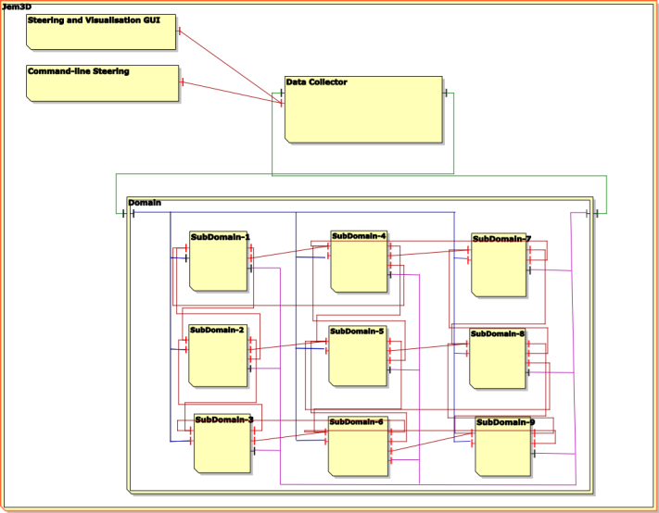
GCM for Parallel Computing
Scopes and Objectives:
Cloud Applications/Services that Compose and Deploy
No programming, No Scripting, …
Innovation:
Abstract Deployment
Composite Components
Multicast and GatherCast

Slide 14
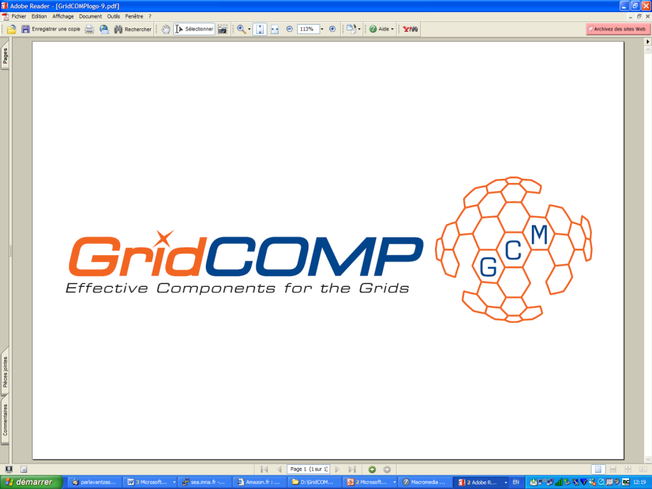
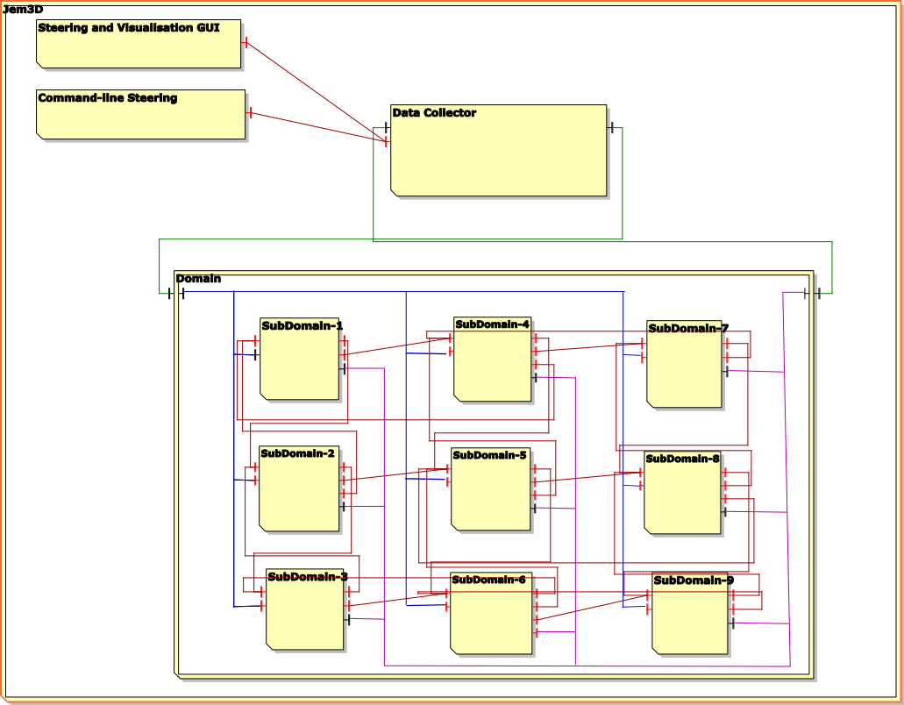
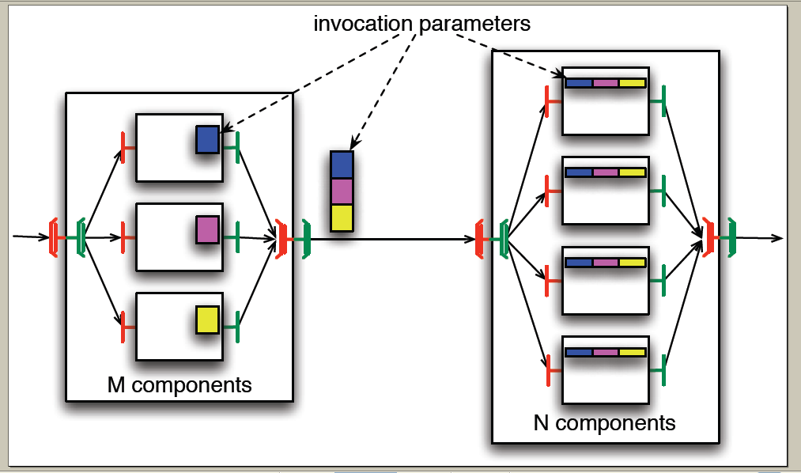
GCM
MultiCast
GatherCast

Slide 15
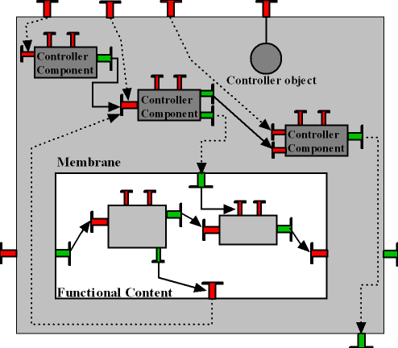
GCM for autonomic computing
Dynamic to Autonomic component-based system reconfiguration
Architecture of GCM membranes
How to plug autonomous strategies to drive all non-functional concerns

Slide 16
AGENDA (part 1)
Context and Motivation:
A short introduction to (safe) component-based applications
academic and industrial examples:
Distributed algorithms;
distributed resiliant industrial infrastructure;
QoS-aware elastic architecture for Cloud applications
Formal Methods and Component models:
Vocabulary and context:
specification, modeling, testing, verification…: Formal methods in the design flow of distributed/embedded systems
Fractal/GCM: a component-based programming model for safe distributed applications
VCE (VerCors Component Editor): a model-driven specification environment for GCM.

Slide 17
Example of distributed systems/algorithms
Distributed Algorithms
BFT : A Fault tolerant algorithm
Distributed Systems in Industry
Reconfigurable large/safe RFID management system
Distributed Services in the Cloud
Architecture for QoS-aware services

Slide 18
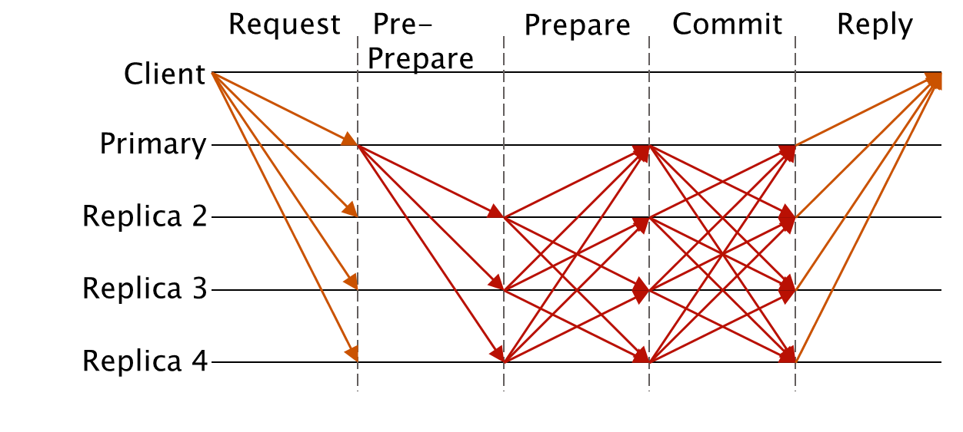
Byzantine Fault Tolerant Systems
Byzantine systems:
“bad” guys can have any possible behaviour,
everybody can turn bad, but only up to a fixed % of the processes.
Very large Bibliography:
Algorithms
Correctness proofs

Slide 19
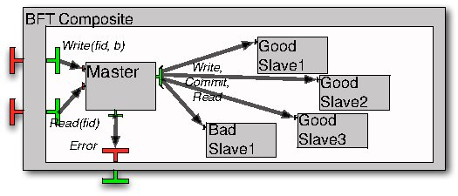
Modelling a BFT application in GCM
Constant « f » : number of faults the system can accomodate.
1 composite component with 2 external services Read/Write.
The service requests are delegated to the Master.
VCE diagram
Fig 3 from paper
Note: 3f+1 slaves
1 multicast interface sending write/read/commit requests to all slaves.
the salves reply asynchronously, the master only needs 2f+1 coherent answers to terminate

Slide 20
Modelling a BFT application in GCM
Challenges:
Analysis of asynchronous group communication: complexity of the interleaving + mastering very large state-spaces
Correctness = termination of service invocation + functional correctness:
expression of logical properties / temporal logics

Slide 21

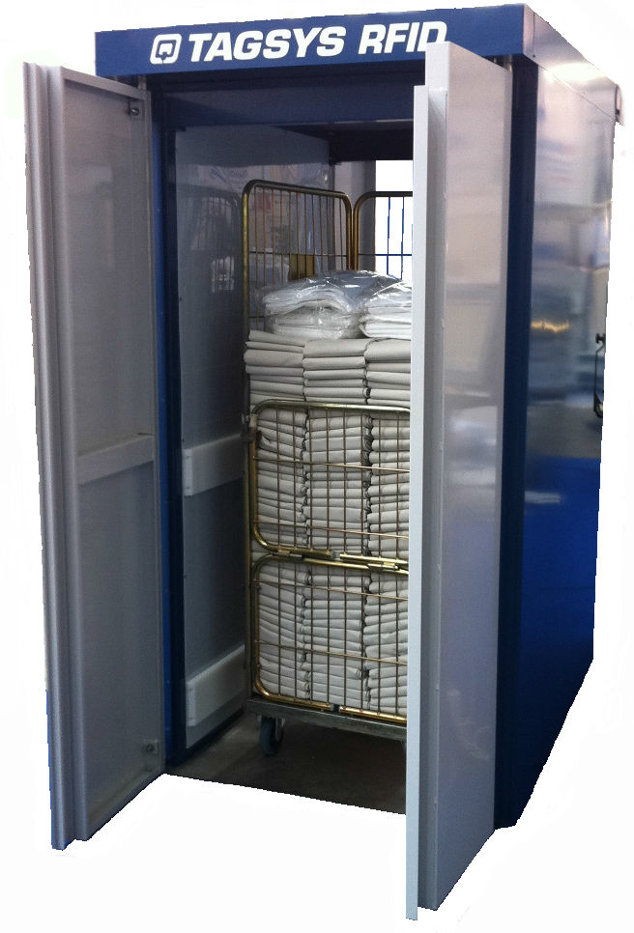
Industrial use-case: Rfid management systems
Collaborative project between INRIA and several academic & industrial partners,
led by TAGSYS-RFID (french SME)
http://www.spinnaker-rfid.com/
Targets widespread adoption of RFID-based systems
Mainly for retail and healthcare sectors

Slide 22



RFID Management systems
Inventory in stores, deliveries, laundries…
Location of people, objects, etc…
Individual identification of large numbers of tags
Large geographically distributed infrastructure
Large flow of data, with safety guarantees
Dynamic topology.

Slide 23
RFID Management systems
Many technological challenges (radiowaves, tags, antennas, energy, …)
Software challenges:
Large / hierarchical
Dynamic
Safety
Database
HM
Supervisor
Company
HM
Customer
ECW Central
Gateway
Stores
HM
Site
ECW Site Gateway
HM
Site
ECW Site Gateway
Rooms
….
HM
Gateway
ECW
Gateway
….
HM
GW
ECW
Gateway
HM
GW
ECW
Gateway
HM
GW
ECW
Gateway
Machine
Equipments
Equipments
Equipments
Equipments

Slide 24
RFID Management systems
Existing infrastructure:
Distributed component-based software
Questions:
How to scale up (from dozens to hundreds of sites)?
How to deploy automatically ?
How to reconfigure without stopping the whole service?
Traceability guarantees for the event storage database.
N. Gaspar, L. Henrio, E. Madelaine,
« Formally Reasoning on a Reconfigurable Component-Based System --- A Case Study for the Industrial World »,
FACS’13, Nanchang, China, oct. 2013.

Slide 25
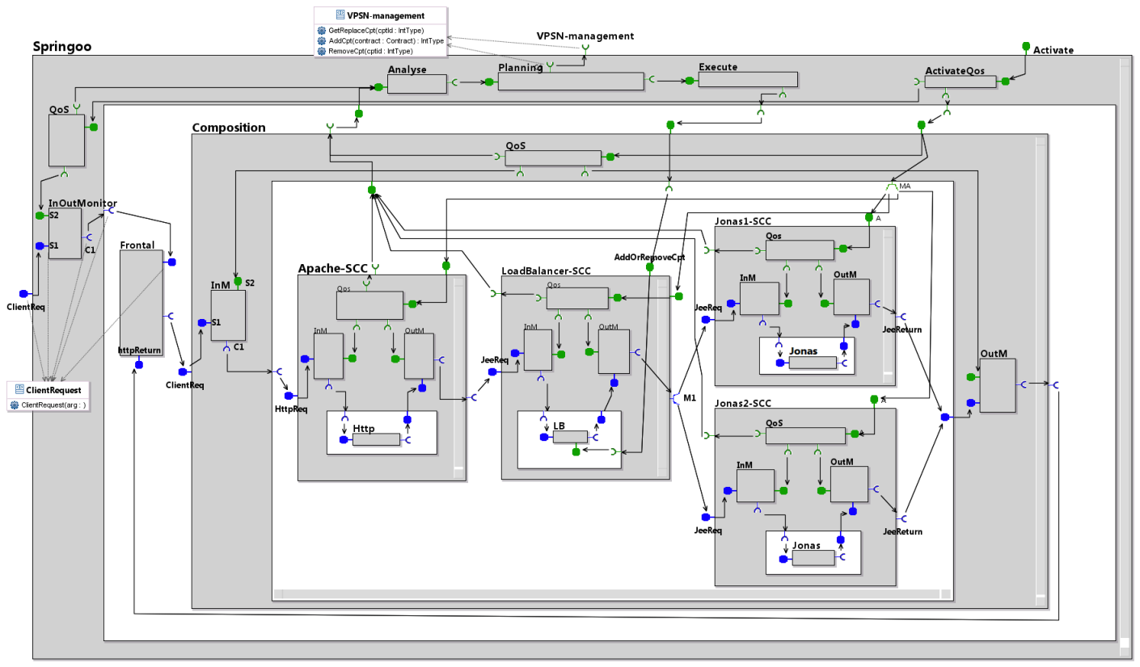
Providing Quality of Service (QoS) for complex Cloud services
Service-based large applications on the Cloud
SLA = contract between user and provider
Shared resources
Predict / monitor performances ?
Adapt configuration and resources to changing demands or environment
MDE helping the application architect

Slide 26
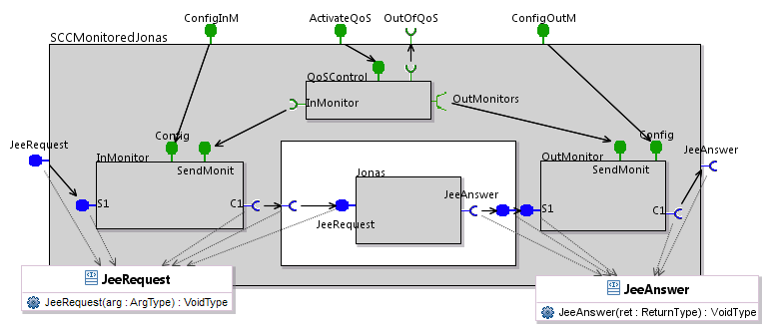
Component Template for QoS
Context: french OpenCloudware project
(leader Orange R&D)

Slide 27
Service Controlled-Component (SCC)
QoS control
Functional (business) component
Monitor

Slide 28
Generic SCC Template
Activation and configuration interfaces
QoS-Control queries the
monitors, and signals In-contract / Out-contract on the NF interface
The monitor component is an interceptor
The interfaces are instantiated for specific request names and types

Slide 29
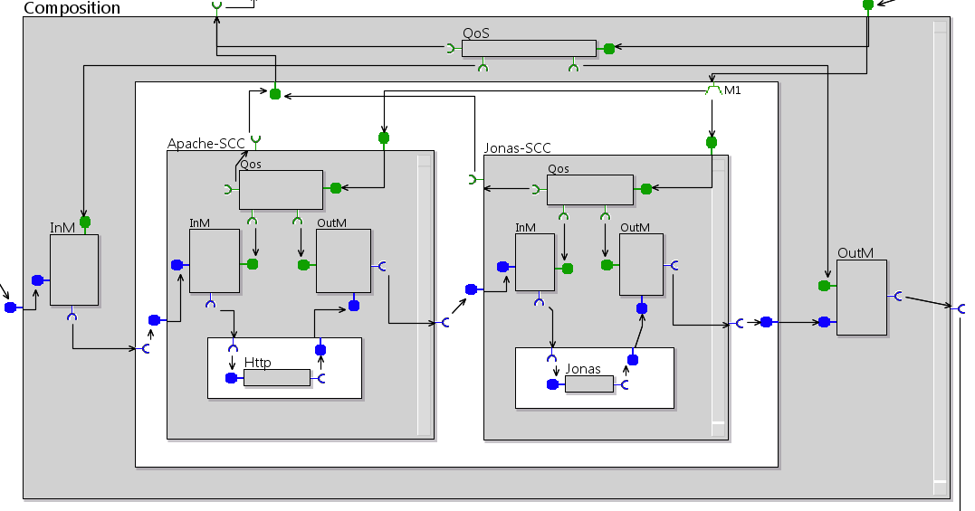
Service Composition
SCC components are composed within GCM composite,
In a distributed, and eventually hierarchical manner (architect choice).

Slide 30
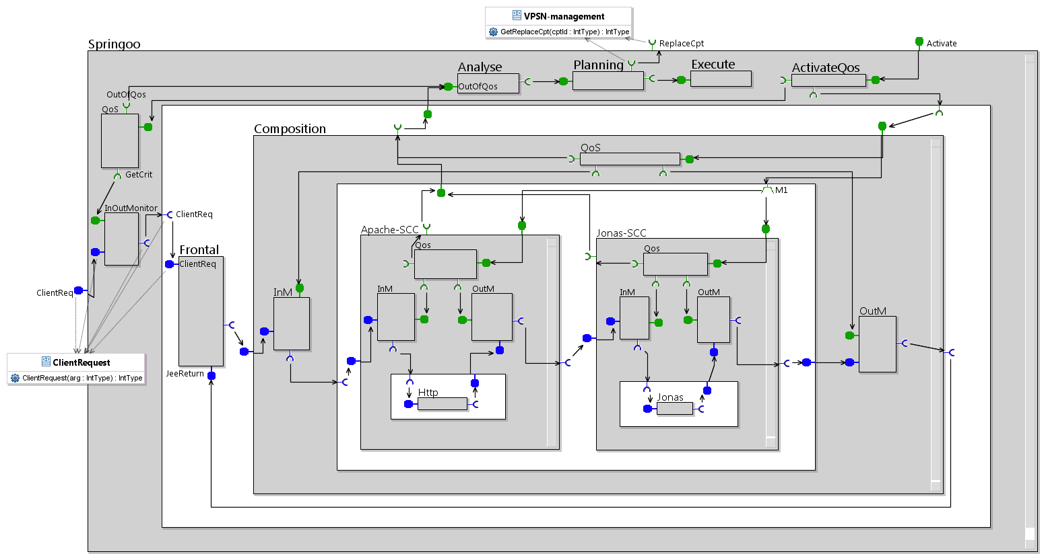
Autonomic management: the MAPE loop
Simply at the toplevel, or eventually distributed and hierarchical

Slide 31
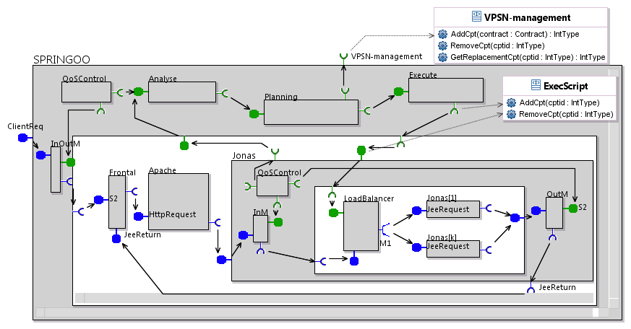
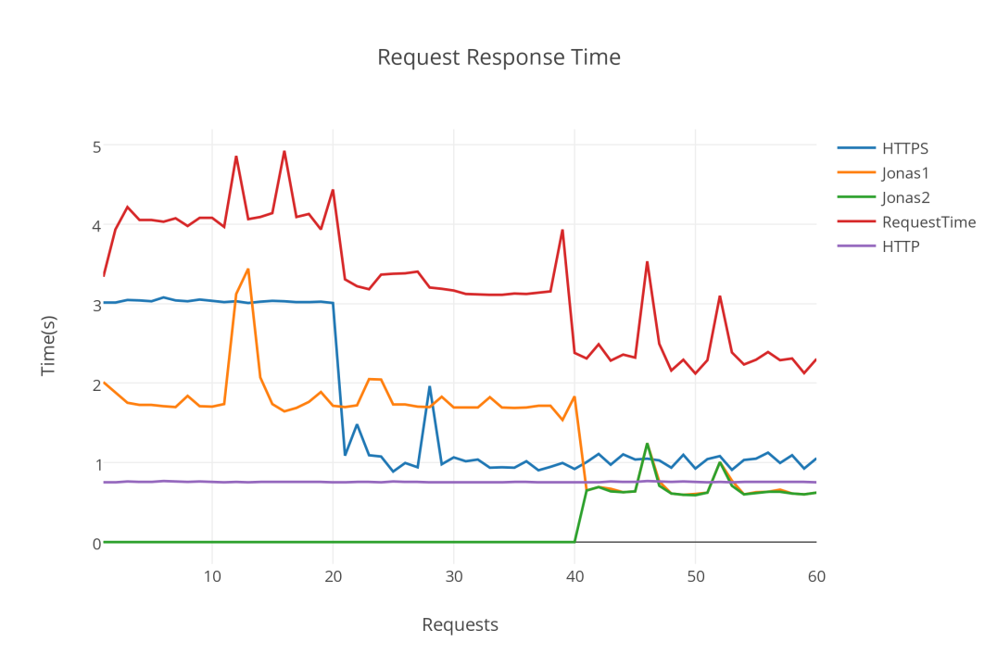
Experiments
Simulation:
Apache -> OutContract
=> Adjust an attribute value
Jonas component too slow
=> Add another instance

Slide 32
AGENDA (part 1)
Context and Motivation:
A short introduction to (safe) component-based applications
academic and industrial examples:
Distributed algorithms;
distributed resiliant industrial infrastructure;
QoS-aware elastic architecture for Cloud applications
Formal Methods and Component models:
Vocabulary and context:
specification, modeling, testing, verification…: Formal methods in the design flow of distributed/embedded systems
Fractal/GCM: a component-based programming model for safe distributed applications
VCE (VerCors Component Editor): a model-driven specification environment for GCM.

Slide 33
Formal methods and the MDE approach
Formal methods :
Provide mathematical semantics to models so that their relation to implemented product can be asserted and proved :
specification formalisms, (temporal) logics
model checking, equivalence checking, theorem-proving
certification, testing
model-based test generation
Modeling languages:
UML and variants (State machines, StateCharts, SysML,…)
Dedicated IDLs and ADLs for system decomposition (…)
Assertion languages (annotations)

Slide 34
Design Cycle
Requirements capture
Sign-off
Global testing
(Initial) specification
Architectural division
Integration
IP component reuse
Component design / programming
Component testing
libraries
Implementation

Slide 35
Design cycle
This Course
Correctness w.r.t. requirements
Requirements capture
Sign-off
Early specification of Architecture and Interaction
Global testing
(Initial) specification
Correct composition: interface compatibility, deadlock freeness, spec implementation
Architectural division
Integration
Test generation
IP component reuse
Synthesis
Component testing
libraries
Black box specification
Correct-by-Construction Implementation

Slide 36
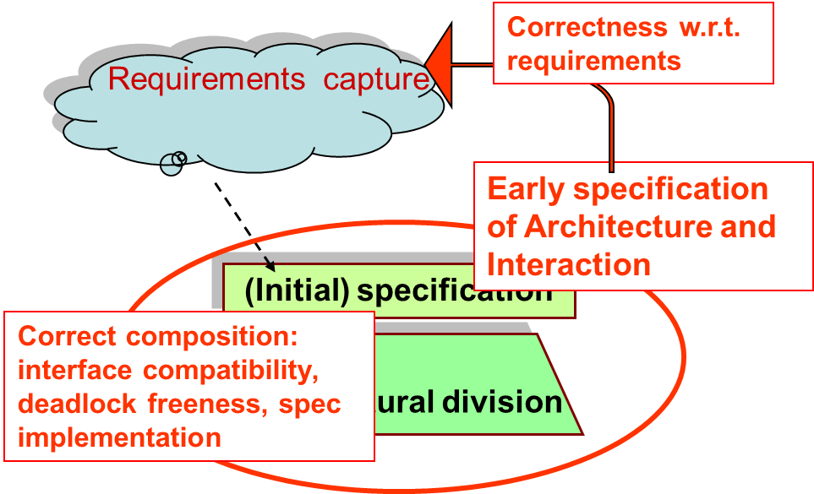
Modeling & Verifying Component Systems
Goal:
Early specification of an Abstract view of the system:
Architecture, Behavior, Requirements.
Model-checking based verification:
Correct composition, Deadlock analysis, Correctness w.r.t. Requirements
Through finite model generation.
Implementation / code generation:
“Correct by construction” code, (partially) generated from models.

Slide 37
AGENDA (part 1)
Context and Motivation:
A short introduction to (safe) component-based applications
academic and industrial examples:
Distributed algorithms;
distributed resiliant industrial infrastructure;
QoS-aware elastic architecture for Cloud applications
Formal Methods and Component models:
Vocabulary and context:
specification, modeling, testing, verification…: Formal methods in the design flow of distributed/embedded systems
Fractal/GCM: a component-based programming model for safe distributed applications
VCE (VerCors Component Editor): a model-driven specification environment for GCM.

Slide 38
At the beginning there was… The Fractal project
Reflective software component model technology for the construction of highly adaptable, and reconfigurable distributed systems
A programming-language independent component model
A set of tools to support programming and assembling
Software industries needs (≠ object-orientation):
Dependencies, assembly, packaging, deployment, configuration
Open and adaptable/extensible
Component [Szyperski, 2002]:
“A component is a unit of composition with contractually specified interfaces and context dependencies only. A software component can be deployed independently and is subject to composition by third parties.”

Slide 39
The Fractal component model
Systems and middleware engineering
Generic enough to be applied to any other domain
Fine grain (opposed to EJB or CCM), close to a class model
Lightweight (low overhead on top of objects)
Independent from programming languages
Homogeneous vision of all layers (OS, middleware, services, applications)
Usable as a component framework to build applications
with “standard” Fractal components
Usable as a component framework framework
building different kinds of components
with minimum introspection and simple aggregation (à la COM)
with binding and lifecycle controllers (à la OSGi)
with a two-level hierarchy and bindings (à la SCA)
with persistence and transaction controllers (à la EJB)
with attribute controllers (à la MBean)
Notes:
Keep as an advertisement, but do not comment during course.

Slide 40
What are (GCM/Fractal) Components?
Bindings
NF (server) interfaces
Server interfaces
Composite component
Client interfaces
Primitive component
Business code
Primitive component
Business code
Hierarchical
Extensible
Reflexive: runtime component management
Separate functional / non-functional concerns

Slide 41
GCM Grid Component Model
A Fractal Extension :
Scopes and Objectives:
Grid/Cloud Codes that Compose and Deploy (on distributed infrastructures)
No programming, No Scripting, …
Innovations:
Abstract Deployment
Multicast and GatherCast
Controller (NF) Components
Standardization
By the ETSI TC-GRID (2008-2010)

Slide 42
GCM: asynchronous model
Distributed components :
No shared memory
Communication = Remote Method Call
Physical infrastructure ≠ logical (virtual) architecture
Large scale Grid/Cloud computations:
Multicast and gathercast interfaces
Asynchrony of computation :
Remote Calls are non-blocking
Notion of Future Objects.

Slide 43
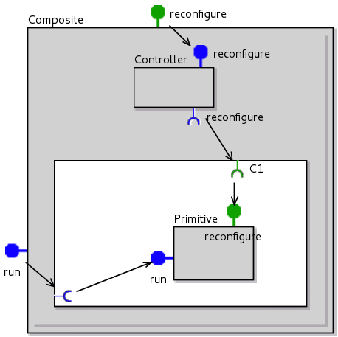
Separation of concerns in GCM architecture
Content: responsible for business logic
Membrane: responsible for control part
Functional and non-functional interfaces
Business logic and control part can be designed separately

Slide 44
Fractal/GCM : controllers
Control
Non functional (technical) properties
Implemented in the membrane
Made of a set of controllers
E.g. security, transaction, persistence, start/stop, naming, autonomicity
Controllers accessible through a control interface
Controllers and membranes are open
Predefined :
Life-cycle
Binding controller
Attribute controller
Content controller

Slide 45
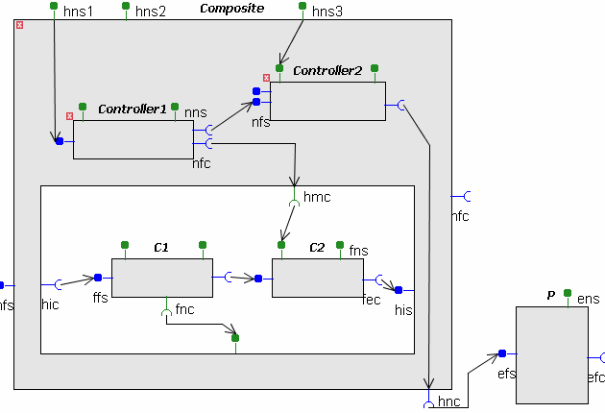
GCM: components for controllers
“Componentize” the membrane:
Build controllers in a structured way
Reuse of controller components
Applications: control components for self-optimization, self-healing, self-configuring, interceptors for encryption, authentication, …
Membrane and controllers:
A way to improve Separation of concerns

Slide 46
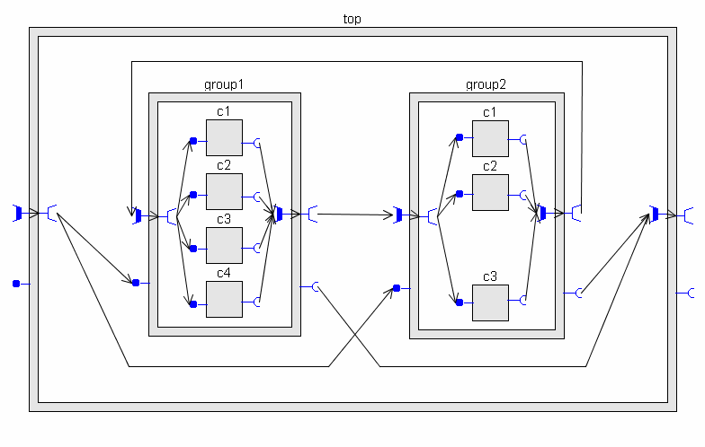
GCM: NxM communication
1 to N = multicast / broadcast / scatter
N to 1 bindings = gathercast
Attach a behaviour (policy) to these interfaces
Group architecture and communication policies:
Allows for (high performance)
very large scale applications,
With easy and portable architecture specification

Slide 47
Summary
Developing large-scale distributed applications is not so easy…
Formalisms and concepts :
Component-based architecture provides structure, composition, reuse, separation of concerns
GCM addresses: distribution and asynchronous communication; large-scale parallel computation; dyamic reconfiguration; monitoring, autonomicity.
Tools ?

Slide 48
AGENDA (part 1)
Context and Motivation:
A short introduction to (safe) component-based applications
academic and industrial examples:
Distributed algorithms;
distributed resiliant industrial infrastructure;
QoS-aware elastic architecture for Cloud applications
Formal Methods and Component models:
Vocabulary and context:
specification, modeling, testing, verification…: Formal methods in the design flow of distributed/embedded systems
Fractal/GCM: a component-based programming model for safe distributed applications
VCE (VerCors Component Editor): a model-driven specification environment for GCM.

Slide 49
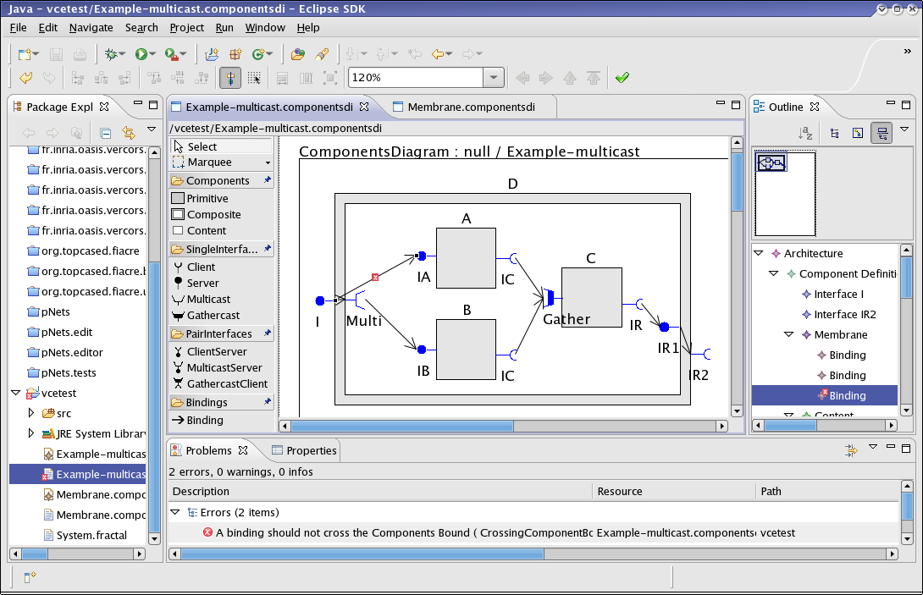
GCM high level specifications: The VCE tool

Slide 50
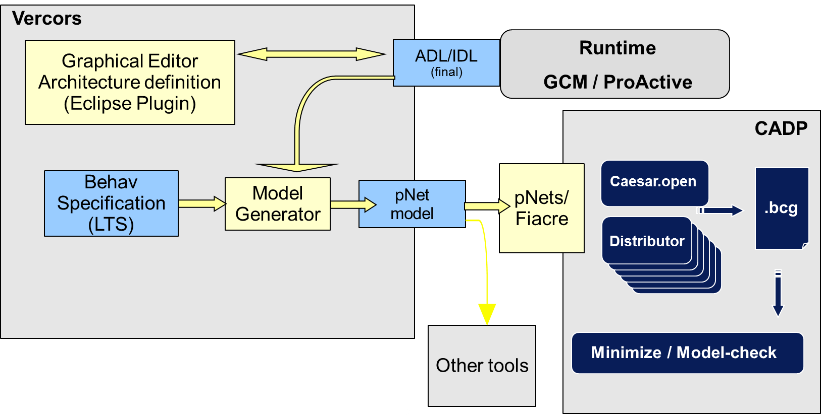
Model-checking applications: The Vercors platform
(partial)
Code generation
Specification:
Graphical
editors
Generation
Of the
Semantic model
Model Checking

Slide 51
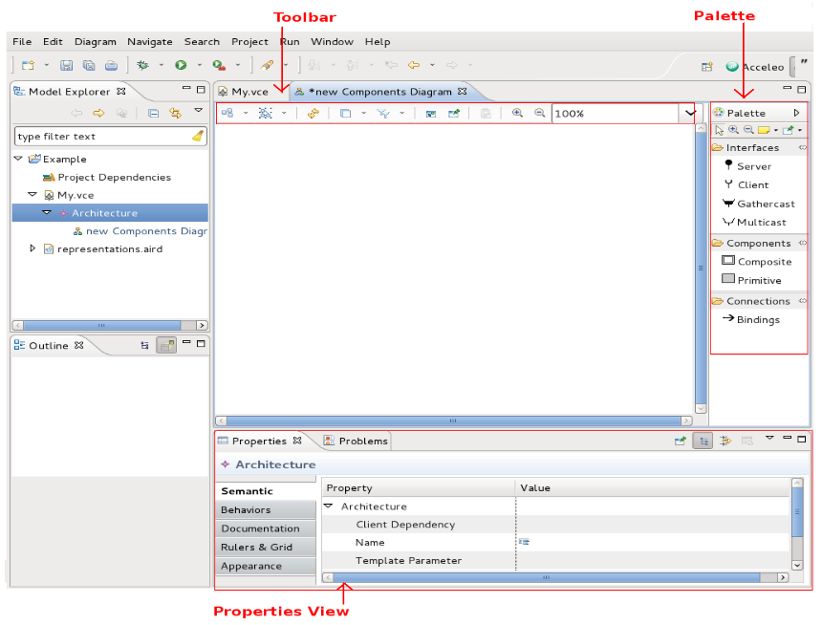
An Eclipse / Sirius environment

Slide 52
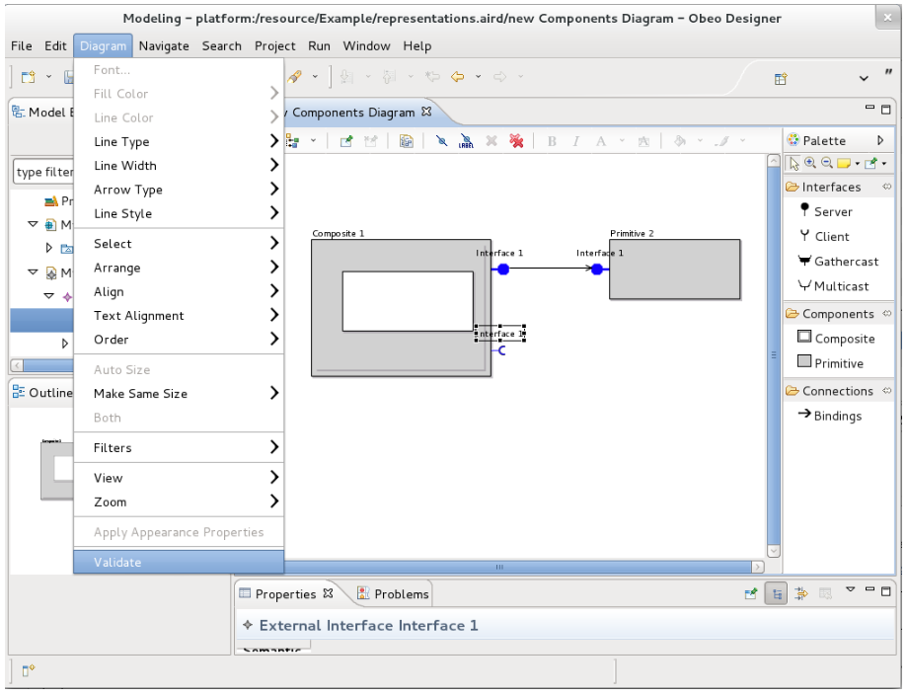
The graphical formalisms: (1) Architecture
GCM full ADL, with full componentized membrane, and multicast/gathercast

Slide 53
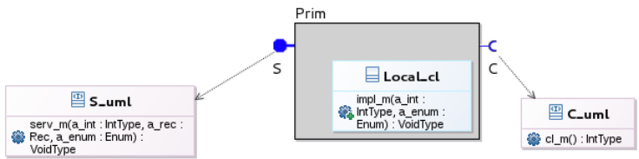
The graphical formalisms: (2) Interfaces
UML class diagram, for interface signatures, and primitive component implementation class

Slide 54
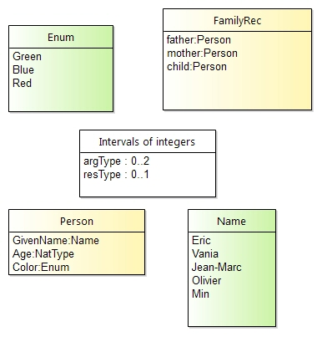
The graphical formalisms: (3) data-types
First order types:
Boolean
Integer and interval
Enumeration
Record
Array (not in this version)
Rational:
Can be easily abstracted into finite domains for model-checking purposes

Slide 55
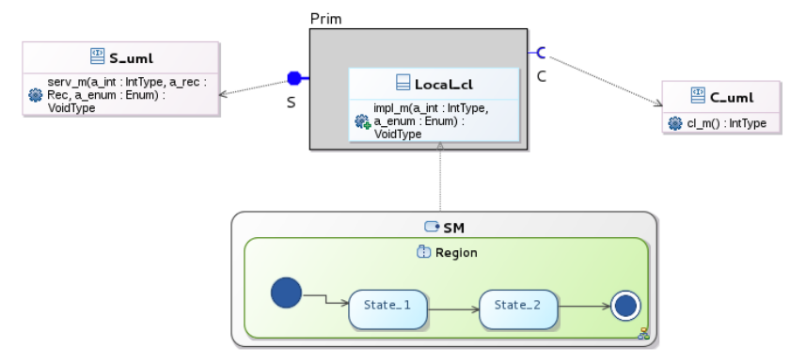
The graphical formalisms: (4) behaviors
UML state machines

Slide 56
The graphical formalisms: (5) action language
The labels of transitions in State-machines express the interaction behavior between components.
Goals:
model generation: easily mapped to Labelled Transition Systems with data (pLTS),
code generation:
Mapped to Java code executable within the GCM/ProActive middleware
Generated code is guaranteed to respect the proved (model-checked) properties

Slide 57
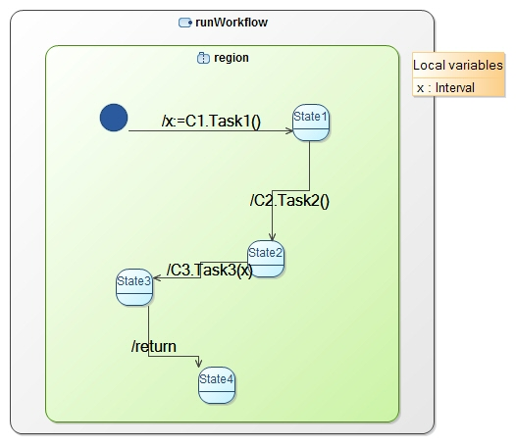
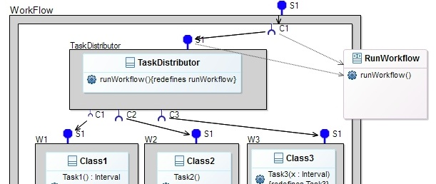
The graphical formalisms: (5) action language
Call method Task1 on client interface C1
Assign result to local variable x
Pass x as a parameter

Slide 58
Validity check, code & model generation
Semantic validity rules:
Structural (components, bindings, interface roles)
Typing (interface compatibility)
Behavioral (variables/methods well-definedness)
Guarantees generation of correct code:
ADL file (for GCM/ProActive component factory)
Behavior model (for model-checking)

Slide 59
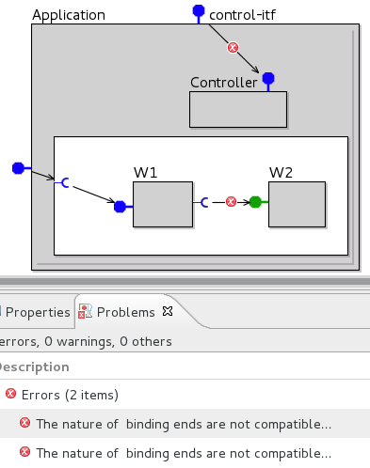
Static validation in VCE
Check all architecture validity the constraints
Use Acceleo, OCL and Java Services
Inform user about the violation of constraints

Slide 60
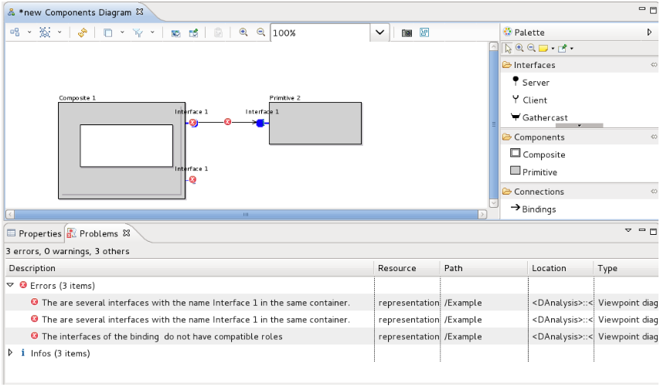
Static validation in VCE

Slide 61
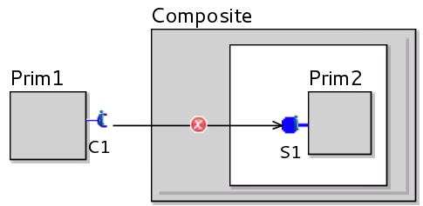
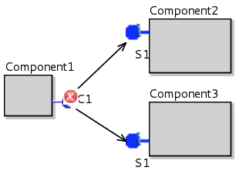
Static validation rules (1)
Component encapsulation
Bindings do not cross the boundaries of the components
Deterministic communications
Each client interface is connected to at most one server interface

Slide 62
Static validation rules (2)
Separation of concerns
The interfaces connected by a binding should have compatible control levels
CL of a functional interface = 1
CL of a non-functional interface = 2
CL is increased by 1 for interfaces of controllers
Compatible CLs: either both = 1, or both >1

Slide 63
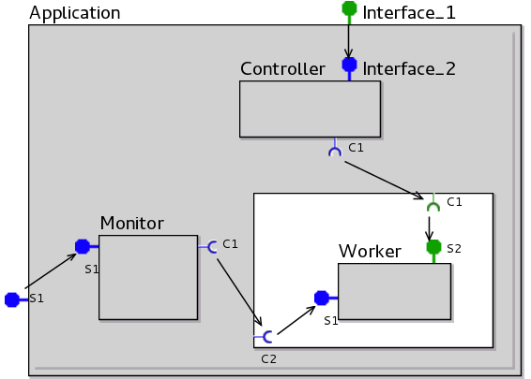
Static validation rules (3)
CL of a functional interface = 1
CL of a non-functional interface = 2
CL is increased by 1 for interfaces of controllers
Compatible CL:
either = 1, or >1
1
2
2
2
2
1
1
1
2
1
1

Slide 64
How far have we gone yet ?
Static
Validation
(partial)
Code generation
Specification:
Graphical
editors
Generation
Of the
Semantic model
Model Checking

Slide 65
MDE for safe distributed systems
Thursday, July 16th , Afternoon(Course)
• 1) Introduction: academic and industrial examples: Distributed algorithms; distributed resiliant industrial infrastructure; QoS-aware elastic architecture for Cloud applications
• 2) GCM: a component-based programming model for safe distributed applications
• 3) VCE: a model-driven specification environment for GCM
Friday, July 17th , Morning: (Hands-on, Lab)
- Presentation and exercises with VCE:
• Tutorial and simple examples
Friday, July 17th , Afternoon: (Lab)
• 1) Course: VerCors theoretical background : behavioural models, model-checking, temporal logics, running the verification tools.
• 2) Hands-on with VCE and Vercors: continued…

Slide 66
AGENDA
Vocabulary and context
specification, modeling, testing, verification…: Formal methods in the design flow of distributed/embedded systems
Modeling Software Component Systems :
Fractal / GCM Component Framework
The VerCors platform:
architecture (ADL) and behavior specification formalisms
Model-checking GCM applications
The BFT case-study

Slide 67
A Glimpse at GCM operational semantics

Slide 68
A Primitive GCM Component
CI.foo(p)
Primitive components communicating by asynchronous remote method invocations on interfaces (requests)
Components abstract away distribution and concurrency
in GCM/ProActive components are mono-threaded ➔ simplifies concurrency but can create deadlocks

Slide 69
Futures for Components
f=CI.foo(p) ……….
f.bar()
f.bar()
Component are independent entities
(threads are isolated in a component)
+
Asynchronous method invocations with results
⬇
Futures are necessary

Slide 70
Replies
…
…
…
f=CI.foo(p)
f.bar()

Slide 71
What is a Future?
Future = Placeholder for an awaited result
Creation of a future
How and when are futures created?
Implicit creation = automatic upon asynchronous invocation (on a remote object)
Explicit creation = there is a future construct
Manipulation and access
How to manipulate the futures?
Explicit access = get operation (+ future type)
Implicit (transparent) access = any variable can contain a future

Slide 72
First-class Futures
…
…
…
f=CI.foo(p)
CI.foo(f)
CI.foo(f)
Only strict operations are blocking (access to a future)
Communicating a future is not a strict operation

Slide 73
First-class Futures and Hierarchy
f=f’
Without first-class futures, one thread is systematically blocked in the composite component.

Slide 74
First-class Futures and Hierarchy
… … …
Almost systematic dead-lock in GCM/ProActive
A lot of blocked threads otherwise

Slide 75
Reply Strategies
In ASP / ProActive, the result is insensitive to the order of replies (shown for ASP-calculus)
experiments with different strategies (lazy, eager)

Slide 76
Summary
Primitive components contain the business code
Primitive components act as the unit of distribution and concurrency (each thread is isolated in a component)
Communication is performed on interfaces and follows component bindings
Futures allow communication to be asynchronous requests
Futures are transparent can lead to optimisations and are a convenient programming abstraction but …

Slide 77
MDE for safe distributed systems
Thursday, July 16th , Afternoon(Course)
• 1) Introduction: academic and industrial examples: Distributed algorithms; distributed resiliant industrial infrastructure; QoS-aware elastic architecture for Cloud applications
• 2) GCM: a component-based programming model for safe distributed applications
• 3) VCE: a model-driven specification environment for GCM
Friday, July 17th , Morning: (Hands-on, Lab)
- Presentation and exercises with VCE:
• Tutorial and simple examples
Friday, July 17th , Afternoon: (Lab)
• 1) Course: VerCors theoretical background : behavioural models, model-checking, temporal logics, running the verification tools.
• 2) Hands-on with VCE and Vercors: continued…

Slide 78
Byzantine Fault Tolerant Systems
Byzantine systems:
“bad” guys can have any possible behaviour,
everybody can turn bad, but only up to a fixed % of the processes.
Very large Bibliography:
Algorithms
Correctness proofs

Slide 79
Modelling a BFT application in GCM
VCE diagram
1 composite component with 2 external services Read/Write.
The service requests are delegated to the Master.
Fig 3 from paper
Note: 3f+1 slaves
1 multicast interface sending write/read/commit requests to all slaves.
the salves reply asynchronously, the master only needs 2f+1 coherent answers to terminate

Slide 80
Our simplification hypothesis
The master is reliable: this simplifies the 3-phases commit protocol, and avoid the consensus research phase.
The underlying middleware ensures safe communications: faulty components only respond to their own requests, and communication order is preserved.
To tolerate f faults we use 3f+1 slaves, and require 2f+1 agreeing answers, as in the usual BFT algorithms.

Slide 81
Requirements (= logical properties)
1- Reachability(*):
- The Read service can terminate
∀ fid:nat among {0...2}. ∃ b:bool. <true* . {!R_Read !fid !b}> true
- Is the BFT hypothesis respected by the model ?
< true* . 'Error (NotBFT)'> true
2- Termination:
After receiving a Q_Write(f,x) request, it is (fairly) inevitable that the Write services terminates with a R_Write(f) answer, or an Error is raised.
3- Functional correctness:
After receiving a ?Q_Write(f1,x), and before the next ?Q_Write, a ?Q_Read requests raises a !R_Read(y) response, with y=x
(*) Model Checking Language (MCL), Mateescu et al, FM’08
Notes:
How the case study was split into a workflow
that can be run as a ProActive Scheduler job on PacaGrid
81

Slide 82
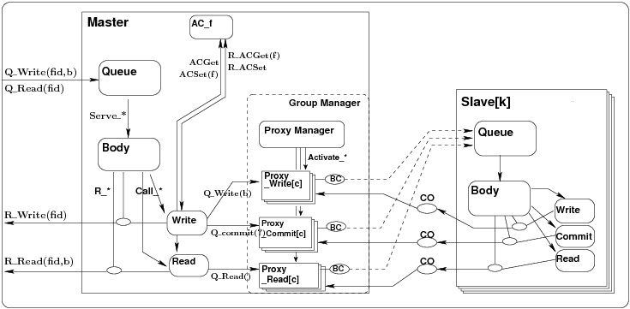
Semantic Model: network of processes (hierarchical, parameterized)
Process hierarchy
generated from VCE
Support for parameterized families
?Q_Write(x)
!Q_Write(b)
Synchronisation vectors

Slide 83
Semantic Model: network of processes (hierarchical, parameterized)
Process hierarchy
generated from VCE
R. Ameur-Boulifa, L. Henrio, E. Madelaine, A. Savu,
« Behavioral Semantics for Distributed Components »,
Research report RR-8167, INRIA, dec. 2012.

Slide 84
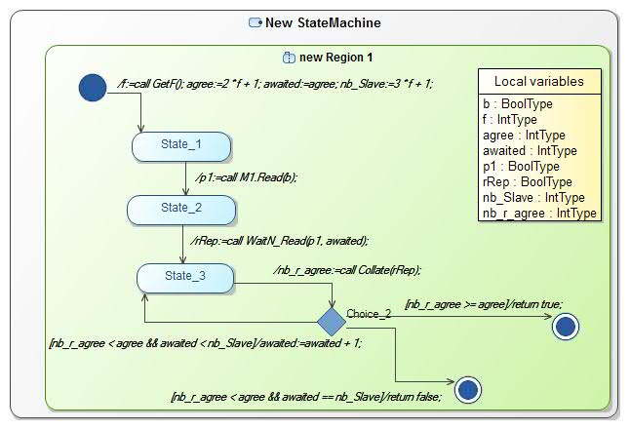
Semantics of State-machines ?
Beware: VCE-v3
Old syntax !

Slide 85
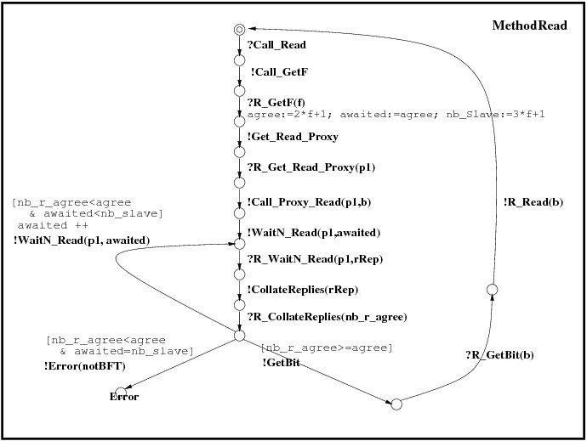
Basic Processes : parameterized LTSs
Labelled transition systems, with:
Value passing
Local variables
Guards….
pLTS
generated from
State Machines
85

Slide 86
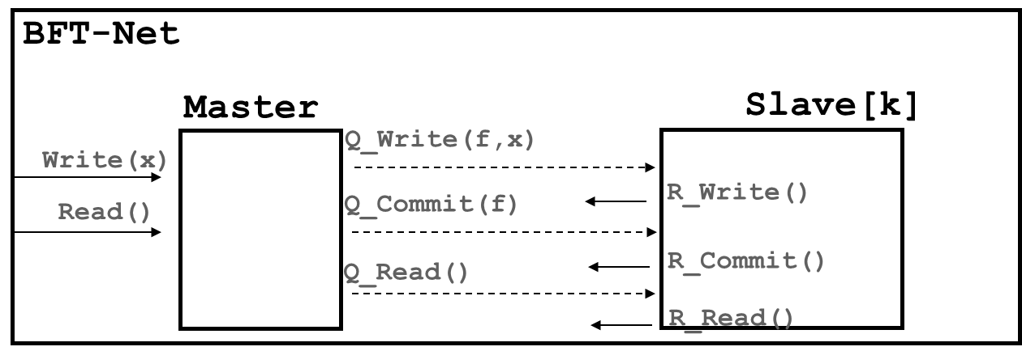
Combining processes: generalized parallel operator
BFT-Net : < Master, Slave_1,…,Slave_n > k ∈ [1:n]
with synchronisation vectors :
<?Write(x), - , …, - > => ?Write(x)
<!Q_Write(f,x), ?Q_Write(f,x) , …, ?Q_Write(f,x) > => Q_Write(f,x)
∀k <?R_Write(f,k), - , …, !R_Write(f), …, - > => R_Write(f,k)
EXP format
(product of automata)
generated by VCE
Notes:
Utiliser Master – Slave[k] ??

Slide 87
Building pNet models (3)
Proxies for Asynchronous group requests
manage the return of results, with flexible policies:
Vector of results
First N results
Individual results
Group Proxy [c]
?Q_m(d)
i ∈ D
!waitN_m(n,x)
CO
R_m(v)
?R_m(x)
Collate
!get_m(x)
!get_m(i,x)
BC
Q_m(d)
i ∈ D
Body
Broadcast
[c]
!Q_m(d)
?get_m(x)
Middleware
(proxies, body, queues)
generated by VCE

Slide 88
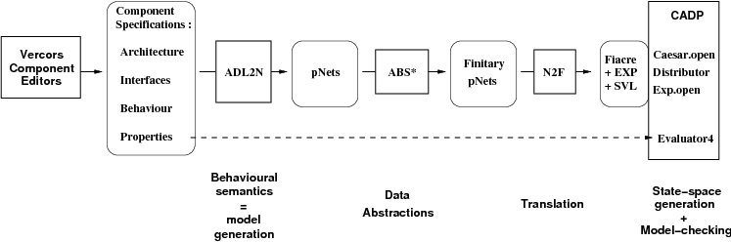
VerCors: Verification Architecture
Goal: fully automatic chain
Current state of the platform:
Production of the CADP input formats (fiacre, exp, svl) fully encoded in VCE, for the basic features of GCM: primitives & composites; state-machines; future proxies, etc…
Not yet included: group communication (multicast/gathercast); first-class futures.

Slide 89
Generation of state-space
Taming state-space explosion:
Data abstraction (through abstract interpretation):
integers => small intervals
arrays … => reduce by symmetry arguments.
Partitioning and minimizing by bisimulation + context specification
Distributed verification engines,
Only partially available (state-space generation, but no M.C.).
3 Tbytes of RAM ?
Notes:
Size problems usually occur essentially during debugging phases…

Slide 90
State-space generation workflow
MQueue.fcr
MBody.fcr
WriteProxy.fcr
Flac +
Distributor
+ Minimize
…
Master Queue
Master Body
Write Proxy
MQueue.bcg
MQueue.bcg
WriteProxy.bcg
Build product
Master.exp
(Hide/Rename)
Minimize
Master.exp
…
Notes:
How the case study was split into a workflow
that can be run as a ProActive Scheduler job on PacaGrid
90

Slide 91
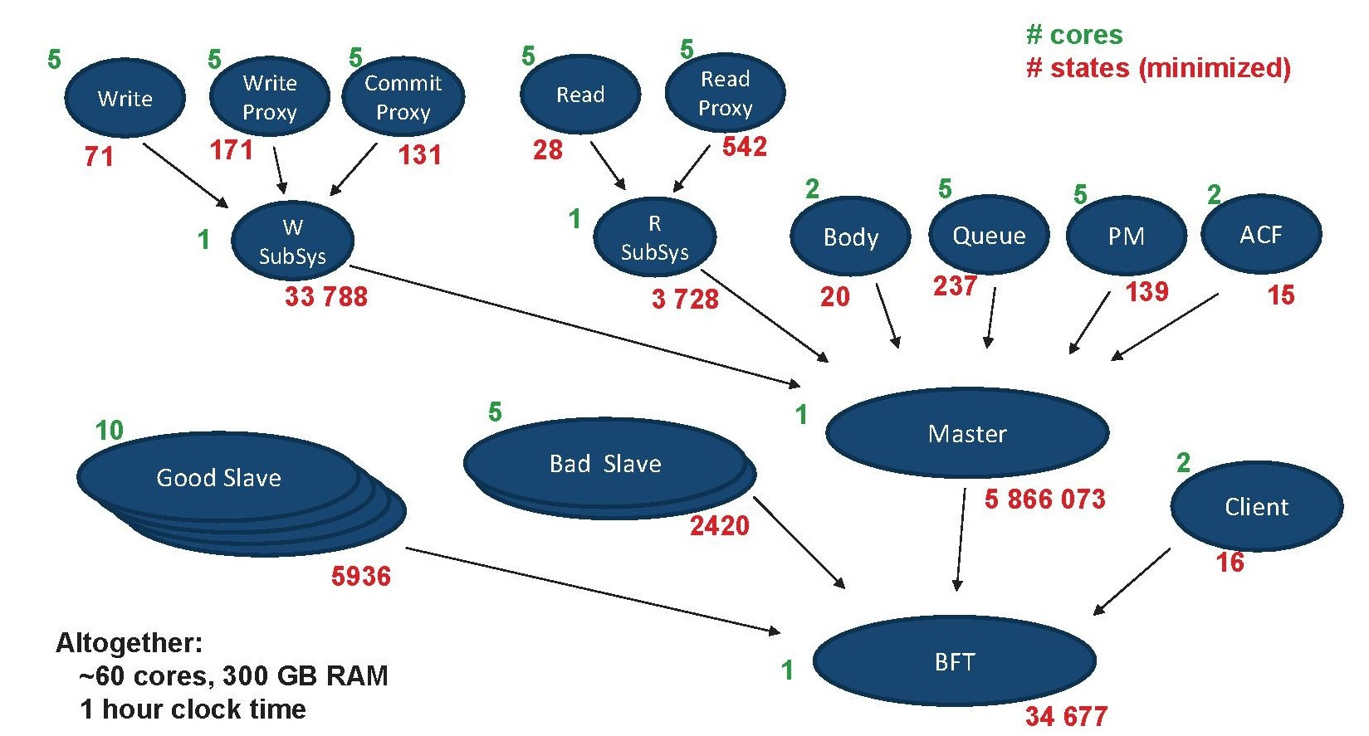
State-space generation workflow
Notes:
How the case study was split into a workflow
that can be run as a ProActive Scheduler job on PacaGrid
91

Slide 92
Distributed State generation
Abstract model: (for a fixed valuation of the parameters):
f=1, (=> 4 slaves), |data|= 2, |proxies|=3*3, |client requests|=3
Master queue size = 2
~100 cores, max 300 GB RAM
System parts sizes (states/transitions):
Queue | Largest intermediate | Master | Good Slave | Global |  | Time
237/3189 | 524/3107 | 5M/103M | 5936/61K | 34K/164K |  | 59’
Estimated brute force state spaces :
10¹⁸ | 6.10³ | ~ 10³²
All properties above have been successfully proven

Slide 93
Some Research Challenges
1 Postdoc
Subject…
Tooling :
hide model-checker internal languages,
show results in user-level formalism.
Scale-up:
better abstraction techniques for useful datatypes (e.g. arrays),
Compositional & symbolic techniques,
minimization of the size of the semantic model
Verifying dynamic distributed systems (GCM + Reconfiguration):
handle Life-cycle and Binding Controllers,
encode sub-component updates,
several orders of magnitude bigger.
=> In the long term, combine model-checking & theorem-proving
1 Master
Internship
1 PhD
Subject
1 Master
Internship

Slide 94
Conclusion
Component frameworks: provide method, tools, middleware for programming large-scale applications
Vercors: an example of a modeling+verification framework for component-based applications
Model-checking distributed component systems: large use-cases – methods for mastering state-space explosion
http://team.inria.fr/scale/Vercors
+ Available master/PhD subjects at INRIA/Scale
+ International Master track at University of Nice Sophia-Antipolis

Slide 95
More References
Fractal & GCM:
http://fractal.objectweb.org/ [doc tutorials]
http://www-sop.inria.fr/members/Eric.Madelaine/Teaching/Ubinet2010/2006-GCM-GridsWork.ppt
F. Baude, D. Caromel, C. Dalmasso, M. Danelutto, V. Getov, L. Henrio, C. Perez: GCM: A Grid Extension to Fractal for Autonomous Distributed Components, in Annals of Telecommunications, Vol. 64, nº1, jan 2009.
pNet [def & semantics]: http://hal.inria.fr/hal-00761073 + PDP-4Pad’15
Overview:
E. Madelaine, Specification, Model Generation, and Verification of Distributed Applications, sept. 2011, URL: http://hal.inria.fr/index.php?halsid=o3253cd31tsjbo0bo40ogqas53&view_this_doc=tel-00625248
Vercors:
http://team.inria.fr/scale/Vercors/software/VCEv4 (download, examples)
Case-studies:
R. Ameur-Boulifa, R. Halalai, L. Henrio, E. Madelaine, Verifying Safety of Fault-Tolerant Distributed Components - Extended Version, RR INRIA #7717, sept 2011, URL: http://hal.inria.fr/inria-00621264/
Nuno FACS’13
Foclasa’14

Slide 96
Thank you
谢谢
Merci
Papers, Use-cases, and Tools at :
http://team.inria.fr/scale/software/vercors

Slide 97
Hands-on Session
Introduction: exercices from the tutorial example
Interfaces, attributes, types, state-machines
BFT application
Composites, Multicast, Matrix
Static Semantics Validation
Use-case: Intelligent cars system
Build a full application with its architectural and behavioral diagrams.

Slide 98
Installation
VCE-v4 installed here for windows platforms. Alpha-version available only since 2015, June : Experimental !
Please report any bugs/problems/badly documented features
Prerequisite: Java7 (jre or jdk) installed
Documents:
Tutorial
Exercices
Thanks a lot
to Siqi Li, and E.C.N.U. & S.E.I. support

Slide 99
BFT
Go to the BFT project, open the VCE architecture diagram
Validate the diagram… what is wrong?
Complete the necessary elements until the diagram is valid.
Add a new Server Interface named “Set F” to the BTF composite component.
Go to the UML Class diagram, add an UML Interface , containing an operation named SetF, with an input argument of type NatType
Attach this Interface to the “Set F” server interface.
Do the same (add a server interface, attach UML interface) for the Master Primitive component
Build the requested bindings… What is missing ?
Check the Diagram Validity.

Slide 100
Composite
Create a new “Composite”project. Build a composite component, with :
Outside:
1 serveur interface SI
2 client interface CI1, CI2
A number of control (NF) interfaces
Inside:
2 subcomponents
One connected to SI
Each connected to one client interface
One binding between them
Check its validity and produce the ADL

Slide 101
Composite, multicast, matrix
Build a composite component, with:
One server interface, with an internal multicast interface
2 x 3 subcomponents representing matrix blocks, each linked to its left and up neighbours

Slide 102
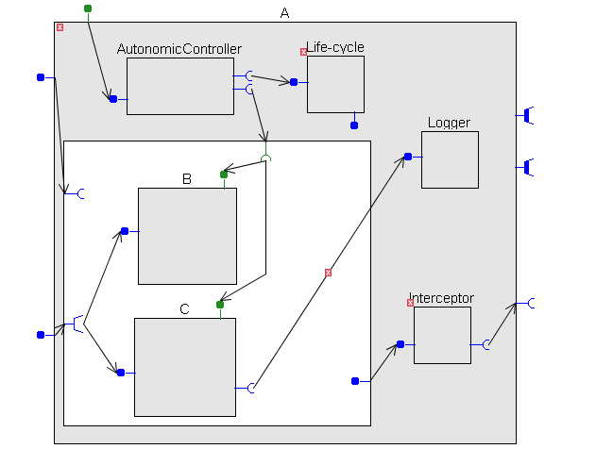
Exercice
Analyze this diagram (semantics, errors, …)

Slide 103
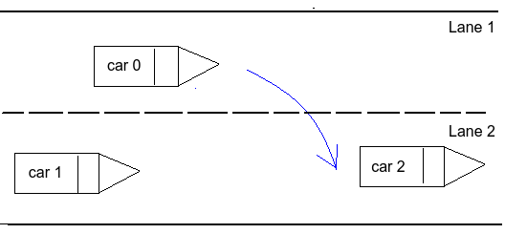
Intelligent cars scenario (from Chen Yanwen PhD research)

Slide 104
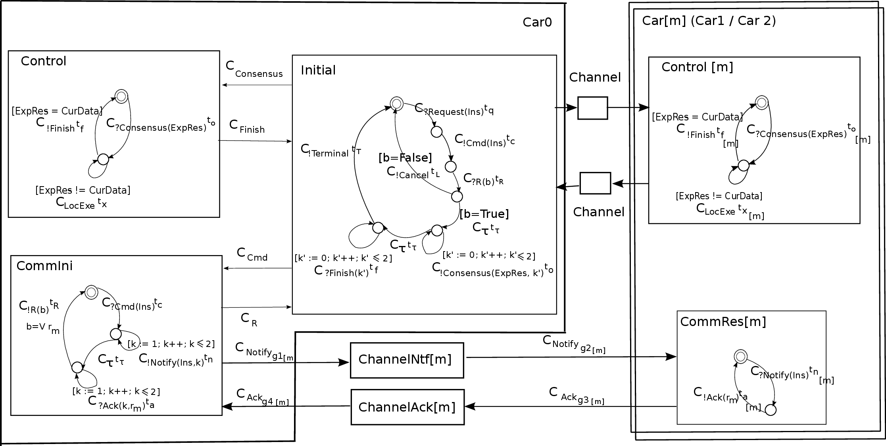
System Architecture

Slide 105
Specific timed model transition language
This use-case was originally built for a timed version of the semantic formalism.
But in the exercises today, only consider the untimed fragment, by dropping the clocks and the time variables.
E.g. in the CommIni component:
C _{?Cmd(Ins)} t _{C} ➔ ?Cmd(Ins)
GCM : RPC style here versus message oriented
(= no return value)

Slide 106
Exercice 1: Architecture
Build a VCE architecture diagram, for the Car0 component, with its 3 subcomponents:
Only the architecture (components, interfaces, bindings) in this first step.
Respect the interface names.
Add a service interface accepting messages from the car driver. Name it “Driver”.
Check the diagram validity.

Slide 107
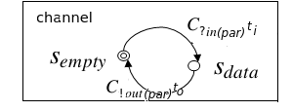
Exercice 2: Channels
Channels here are primitive components with a specific behavior template:
Draw a primitive component with interfaces S1 and C1. Build the UML class diagram of these interfaces, and of the implementation class for the method “In” of the service interface S1.

Slide 108
Exercice 3: Channels behavior
See
Tutorial
Section 2.9
A channel repeatedly receives “In” requests on its service interface. The “In” method receives a parameter, calls the “Out” method on the client interface, then returns.
Attach a state-machine specifying the behavior of the service method “In”.
Use xtext to create the label of the “C.Out” transition of this machine.

Slide 109
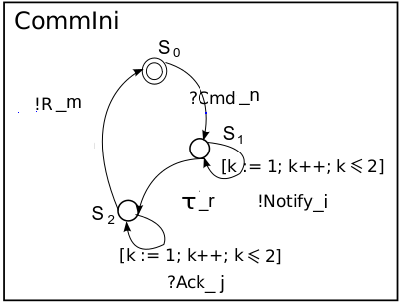
Exercice 4: CommIni component

Slide 110
Exercice 4: CommIni component
This is more complicated…:
CommIni has 2 service interfaces (bound from Initial and from ChannelAck).
When receiving “Cmd(Ins)” from Initial, it sends a number of “Notify” on client Itf ChannelNotify, then wait.
When receiving “Ack(k,r)” from ChannelAck, it stores the corresponding “r_k”. We suppose it receives them in order.
When all received, it computes the result and sends it on Itf “ToInitial”
The way to formalize this in GCM is with 2 service methods, plus a local “body” method describing the (statefull) behavior policy.
Build the class diagram for this impl. Class, then the State machines for the service methods and the body.

